Slide 1
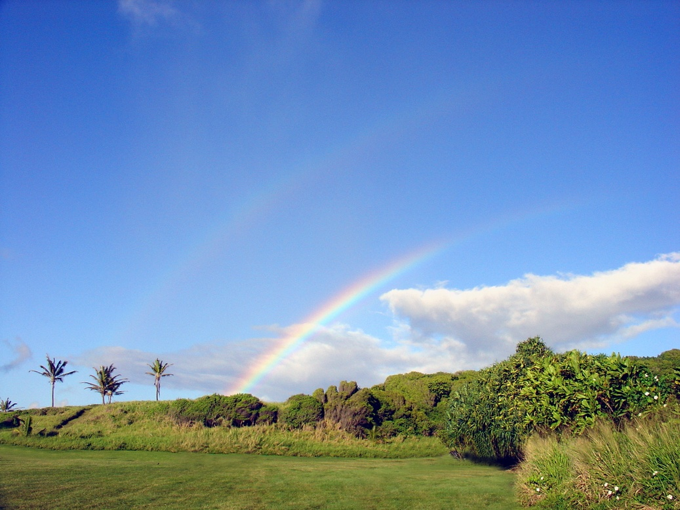
Weather & Climate

Slide 2
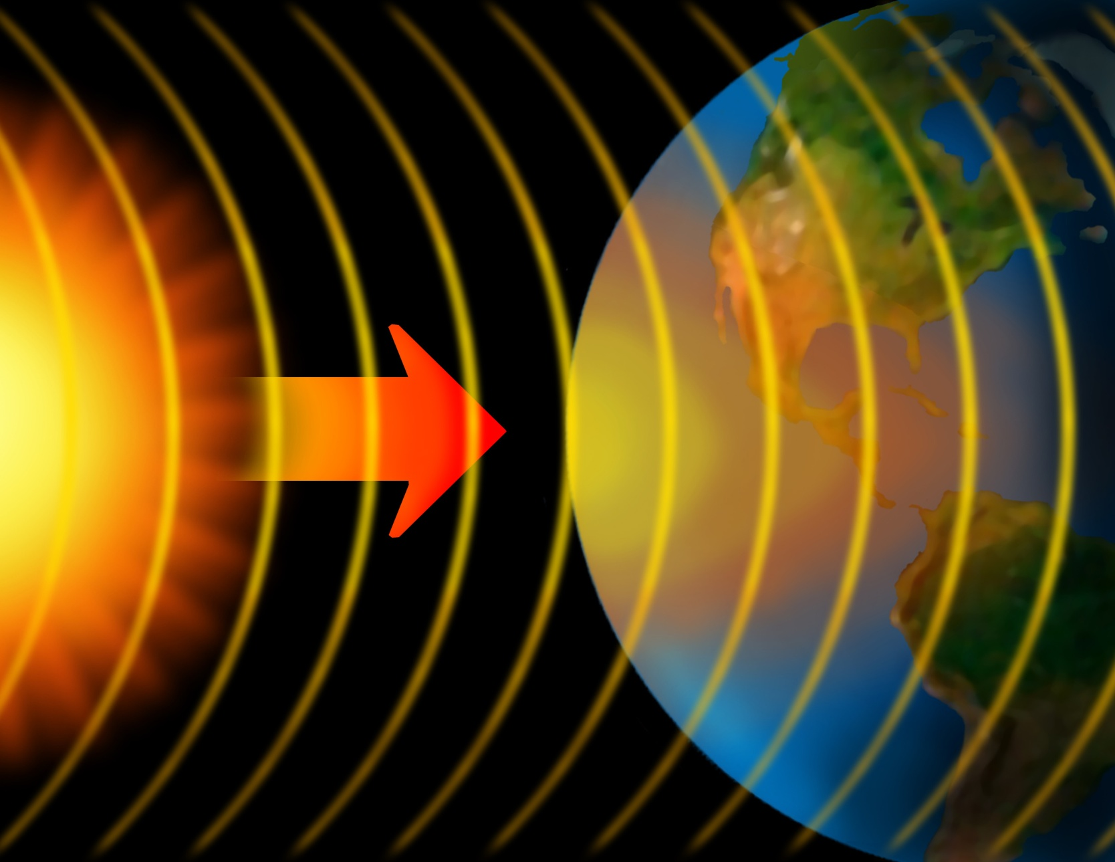
Weather begins with the sun
Notes:
Weather systems start because the sun’s energy heats up some parts of Earth more than others. Solar energy heats the equator more than the poles.

Slide 3
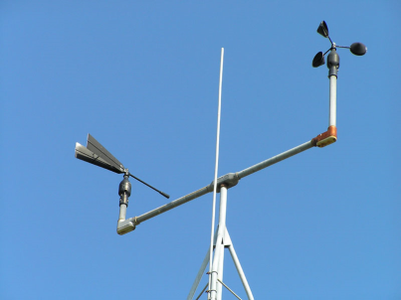
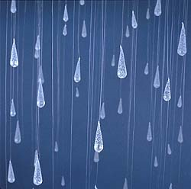
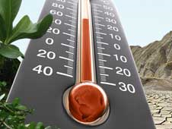
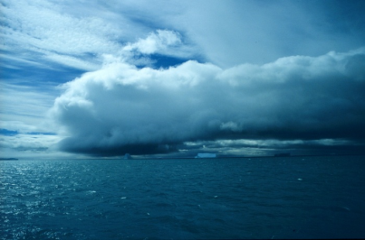
Some Weather Factors
Wind. This tool measures wind speed. It is called an anemometer.
Precipitation. Rain, snow, sleet and hail are all forms of precipitation.
Temperature. Temperature is how warm or cold it is outside.
Cloud Cover. There are many types of clouds that form in different conditions.
Notes:
In addition to the factors above, weather also includes factors such as UV radiation levels and air pressure. In Hawaii, UV levels are generally high die to the great amount of sun received. Air pressure affects a variety of weather conditions. Generally speaking, high air pressure means good weather and low pressure means potentially bad weather.

Slide 4
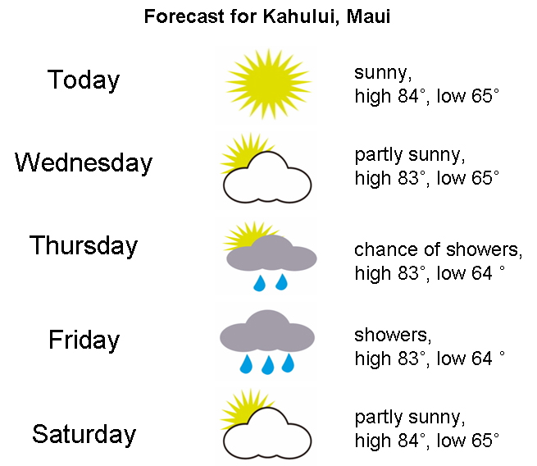
Weather changes every day!
Notes:
Hawaii’s weather remains fairly consistent in temperature, although precipitation can vary greatly from day to day or from location to location. Other states can experience big changes in day to day weather.

Slide 5
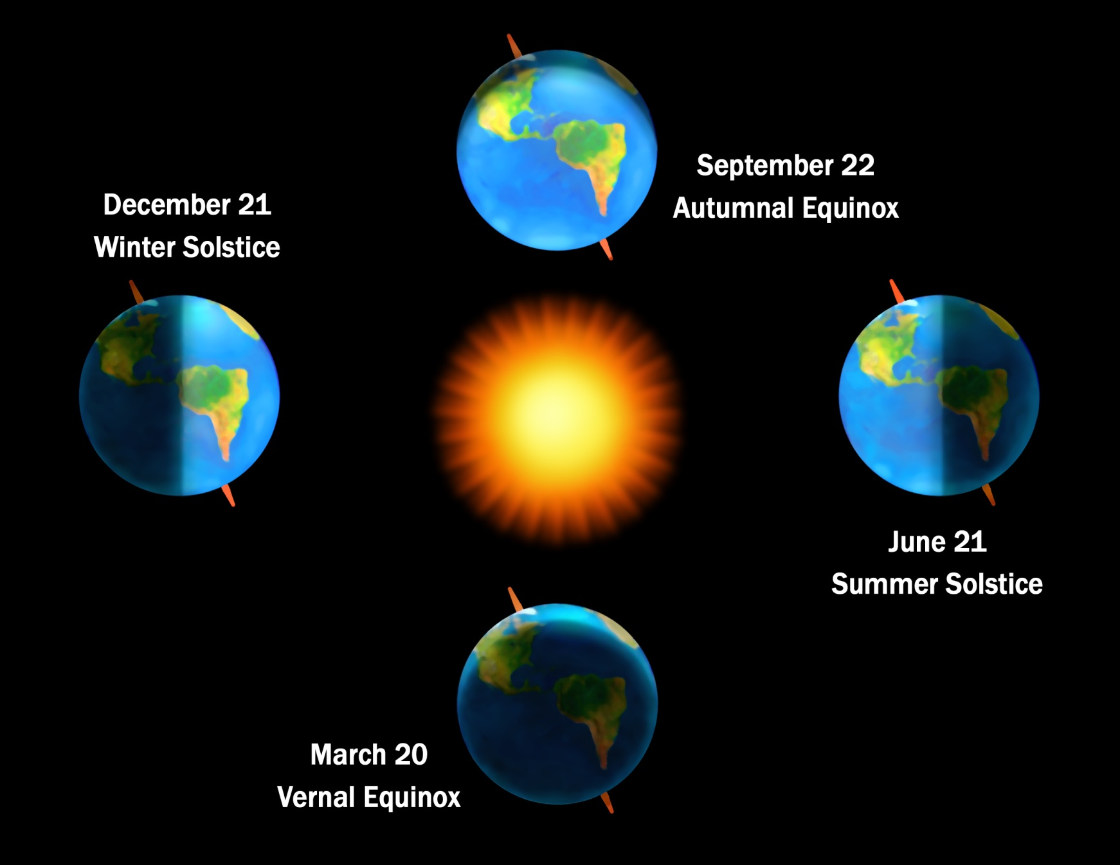
Seasons on Earth
Notes:
Seasons exist because the earth tilts on its axis towards the sun at different angles. As the sun shines on the earth, it shines more directly on the northern hemisphere in June, and more directly on the southern hemisphere in December. That's why the seasons are different in each hemisphere. In the spring and fall, the sun shines fairly straight on the equator, giving both hemispheres equal warming.
Weather changes as seasons change.

Slide 6
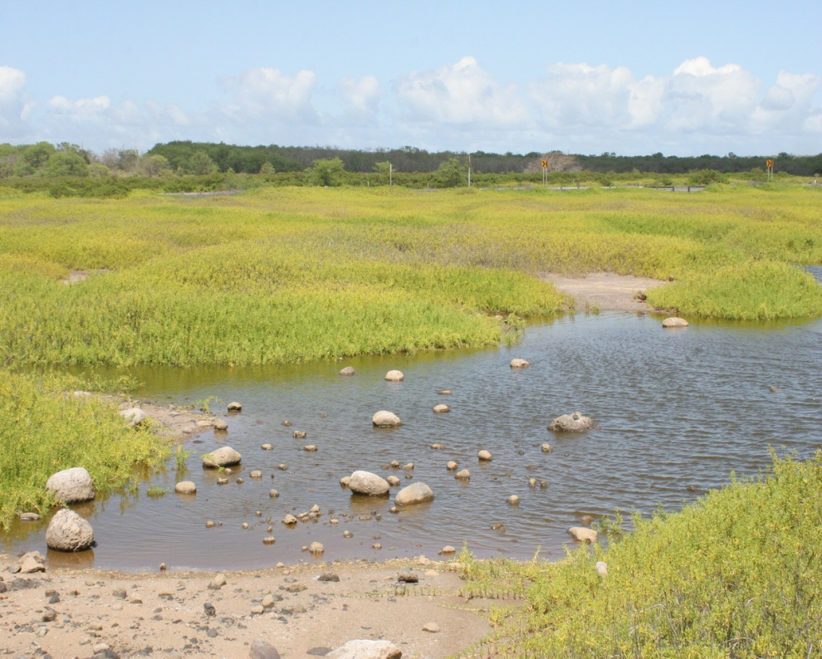
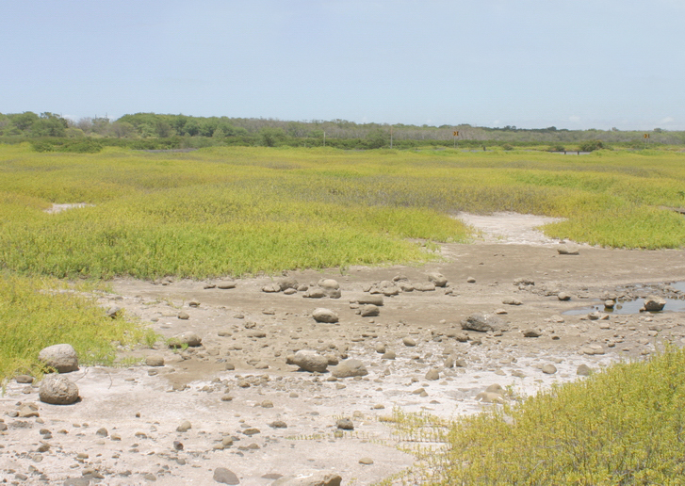
Hò oilo - Wet Season
Native Hawaiians
recognized only two seasons
Kau - Dry Season
Notes:
This picture shows the same view of Kealia Pond, Maui, taken at different times of the year. The picture on the left was taken during the winter and the picture on the right was taken during the summer.
Native Hawaiians recognized only two seasons. Kau was the fruitful season, May through October, the season when the sun was directly or almost directly overhead, when the weather was warmer, and when the trade winds were more reliable. Hoo-ilo, November through April, was the season when the sun was in the south, when the weather was cooler, and when the trade winds were sometimes interrupted by other winds. If one uses a slightly different “calendar” with a winter season of seven months (October through April) and a summer season of five months (May through September), summer is very definitely the warmer season, the season with an overwhelming dominance of trade winds, and the season when widespread rainstorms are rare. Also throughout the lowlands, summer is the drier season in terms of average monthly rainfall, except on the Kona Coast (leeward coast) of the Island of Hawaii.

Slide 7
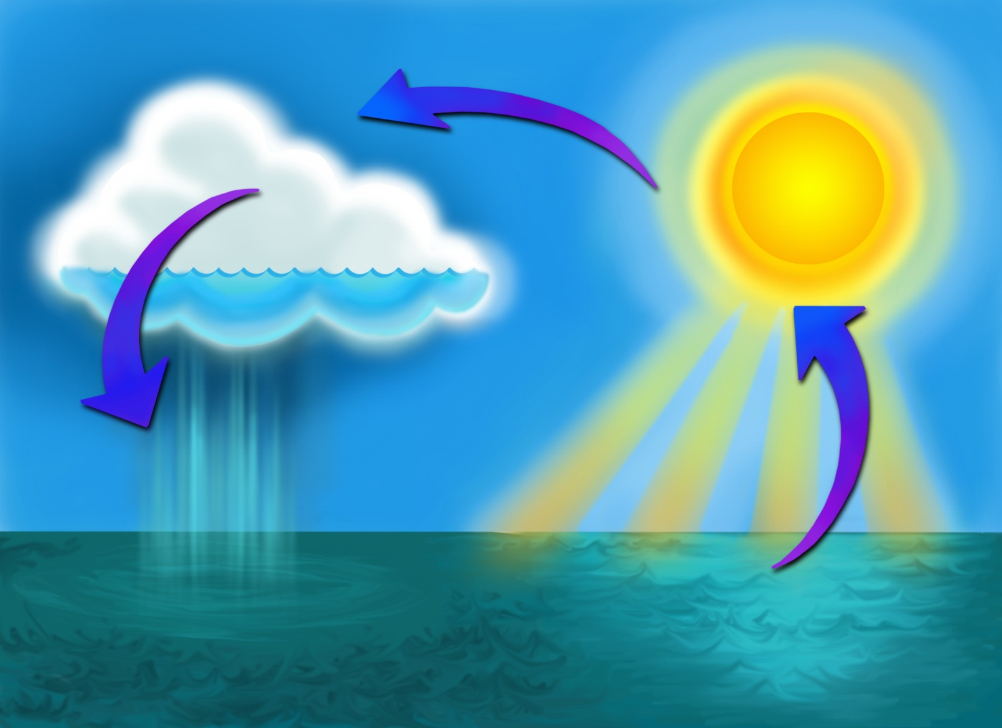
The water cycle affects both climate and weather
Notes:
The water cycle is powered from solar energy. The sun evaporates water from the entire Earth - 86% of the evaporation on Earth comes from the oceans. Evaporation cools the atmosphere and planets. The water cycle involves the evaporation, condensation and precipitation of water and all of these events shape the weather on a day to day basis. Evaporation and precipitation are ways in which water moves through the water cycle on any given day during a weather event.
During certain times of year and certain seasons, it might rain often causing plants, soils, rivers, and lakes to absorb more water. During other times of year, hot, dry weather can lead to water evaporation causing plants and soil to dry out and streams and rivers to have lower elevations, but over the course of a year or several years, a balance occurs in the water cycle so the amount of water entering the system is equal to the amount exiting. This balance in the water cycle helps stabilize the climate. Climate is affected by the natural fluctuation of the balance of water entering and exiting the system on a global scale.

Slide 8
Climate is weather measured over a long period of time
Weather = clothes for the day
Climate =
clothes in a closet
Notes:
The climate is the common, average weather conditions at a particular place over a long period of time (for example, more than 30 years). Think of climate as all the clothes in your closet – everything you need to wear to be comfortable all year. Think of weather as the clothes you wear for the day.

Slide 9
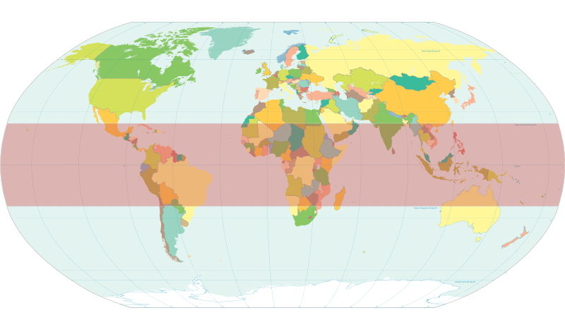
Climate Zones:
Low-Latitude Climates
affected by equatorial tropical air masses
Notes:
Low-latitude climates include the tropical moist (rainforest), wet-dry tropical (savanna), and dry tropical (desert) climates.
The climate of an area is a composite of various kinds of weather. The outstanding features of Hawaii's climate include mild temperatures throughout the year, moderate humidity, persistence of northeasterly trade winds, significant differences in rainfall within short distances, and infrequent severe storms.
(http://www.prh.noaa.gov/hnl/pages/climate_summary.php)
For photos of places in the low-latitude climates, click “Climate Zones” on the right side toolbar of webpage:
http://oceanservice.noaa.gov/education/pd/oceans_weather_climate/welcome.html

Slide 10
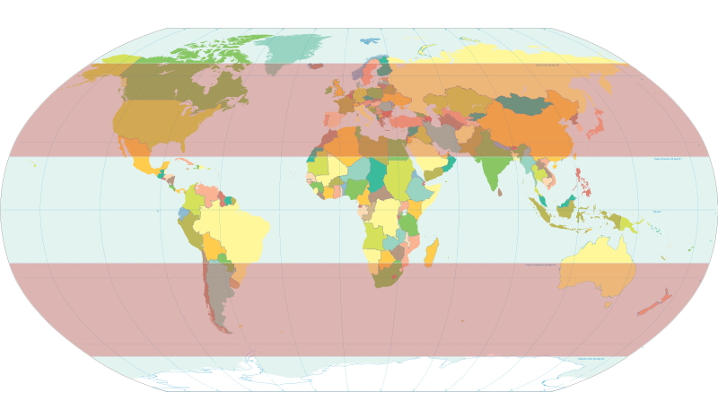
Climate Zones:
Mid-Latitude & Subtropical Climates
affected by two air masses: tropical air moving toward poles and
polar air masses moving toward equator
Notes:
This climate zone includes the dry-midlatitude, Mediterranean and moist continental climates.
For photos of places in the mid-latitude climates, click “Climate Zones” on the right side toolbar of webpage:
http://oceanservice.noaa.gov/education/pd/oceans_weather_climate/welcome.html

Slide 11
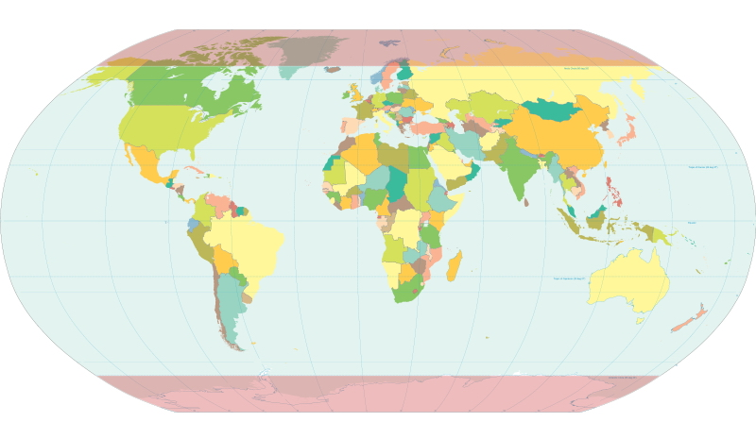
Climate Zones:
High-Latitude Climates
dominated by polar and arctic air masses
Notes:
This climate zone includes the boreal forest, tundra, and highland (alpine) or cold climates.
For photos of places in the high-latitude climates, click “Climate Zones” on the right side toolbar of webpage:
http://oceanservice.noaa.gov/education/pd/oceans_weather_climate/welcome.html

Slide 12
In which climate zone does Hawai‘i belong?
high latitude
mid latitude
Hint:
Hawai‘i belongs in a combination of two climate zones
low latitude
Notes:
Hawai`i is located in the tropics and the closeness to the equator would mean much higher temperatures but for the natural air conditioner that our trade winds provide. Hawai‘i has unique ecosystems and weather characteristics. Climates we encounter include humid tropical zones, arid and semi-arid zones, temperate zones, and at a (very) few locations, Alpine zones.

Slide 13
In which climate zone does Hawai‘i belong?
high latitude
mid latitude
Hint:
Hawai‘i belongs in a combination of two climate zones
low latitude
Notes:
Additional Info: The varied topography of Hawai`i creates several microclimates: windward lowlands, leeward lowlands, interior lowlands, rainy mountain leeward slopes, lower mountain leeward slopes, and high mountains. Each microclimate generally has its own wind patterns, temperature range, and precipitation patterns. The leeward sides of the islands are characterized by higher daytime and cooler nighttime temperatures. The area receives below-average amounts of precipitation compared to the windward side of the islands. The majority of the precipitation comes from winter storms carried by southwestern winds. The unique geography of each island creates wind patterns that are different between leeward and windward sides.

Slide 14
The End

