Slide 1
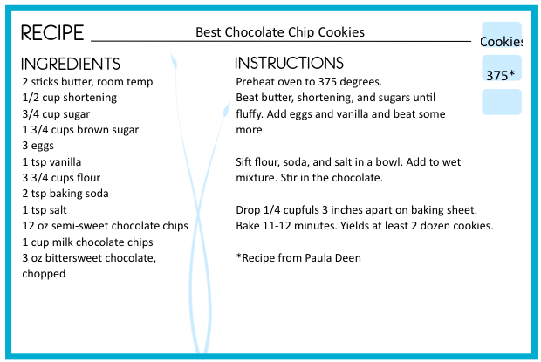
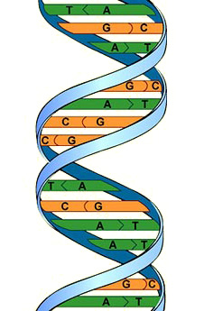
What would you use each of these instructions for?

Slide 2
This recipe gives instructions for making chocolate chip cookies.

Slide 3
These instructions can be used for making an origami lion.

Slide 4
This blueprint gives instructions for building a house.

Slide 5
This DNA contains instructions that specify an organism's traits.

