Slide 1
Inventory of Traits Pictures

Slide 2
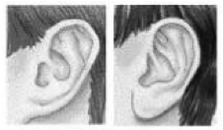
1. I have detached earlobes.
attached earlobe
detached earlobe

Slide 3
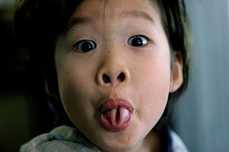
2. I can roll my tongue.
rolled tongue

Slide 4
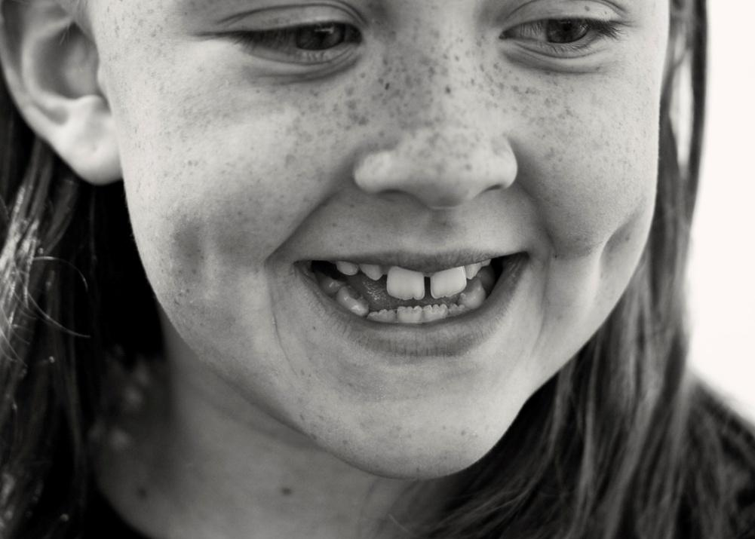
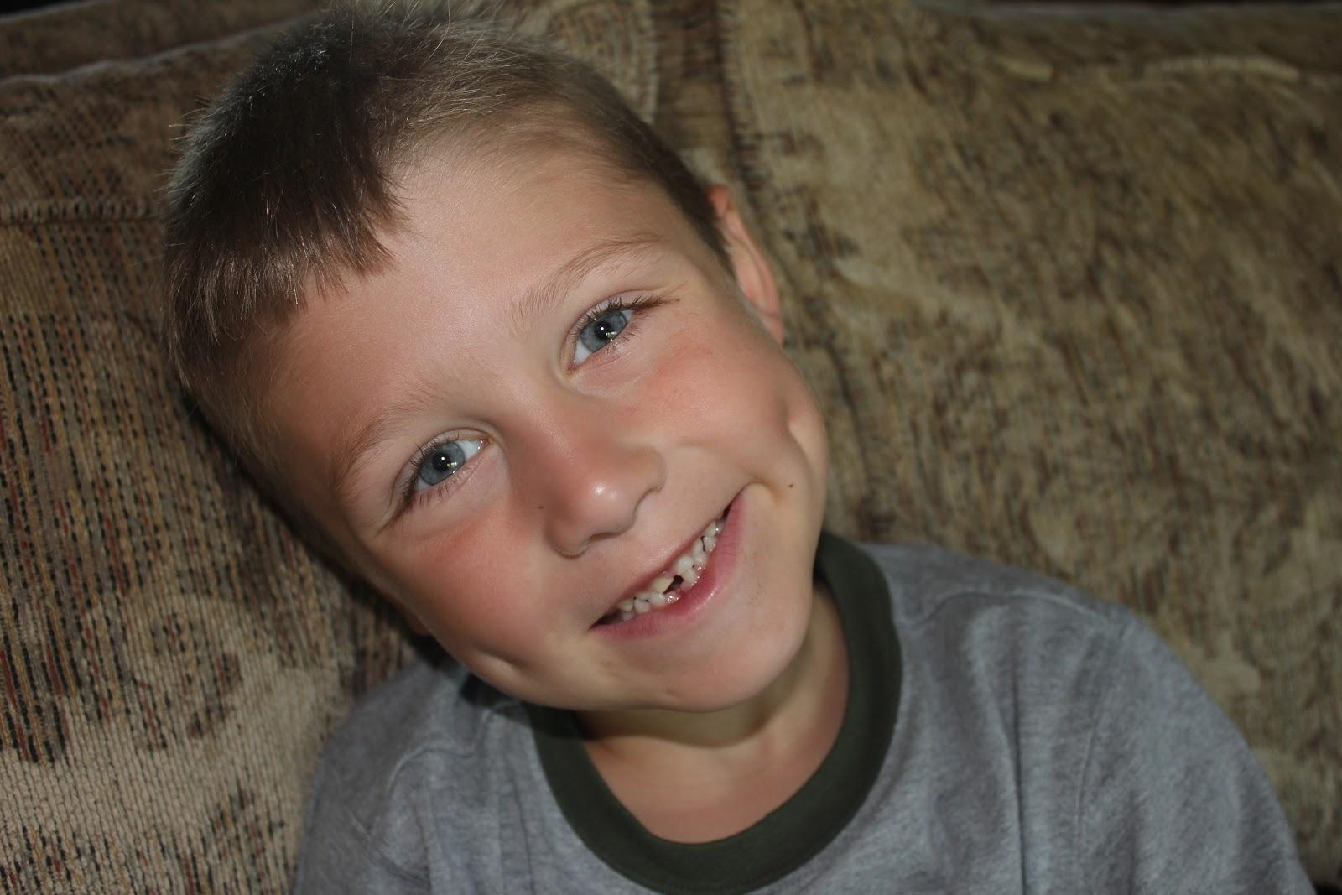
3. I have dimples.
dimples

Slide 5
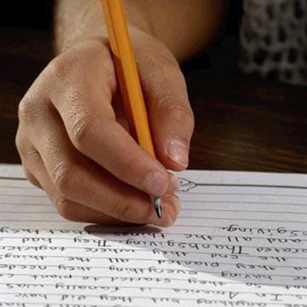
4. I am right-handed.
right-handed

Slide 6
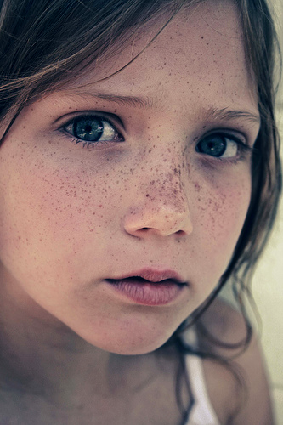
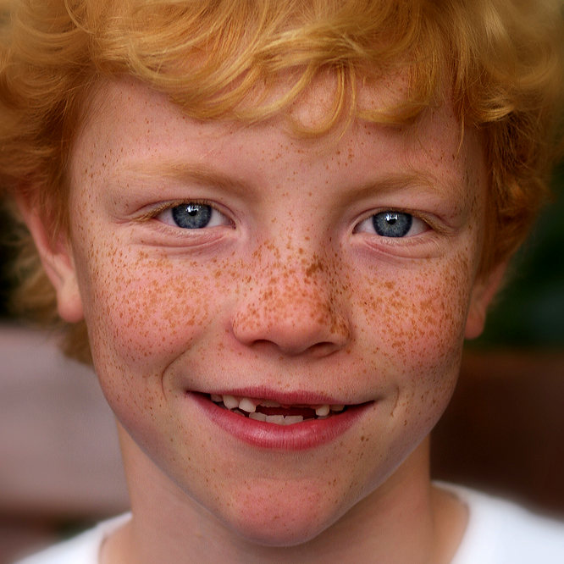
5. I have freckles.
freckles

Slide 7
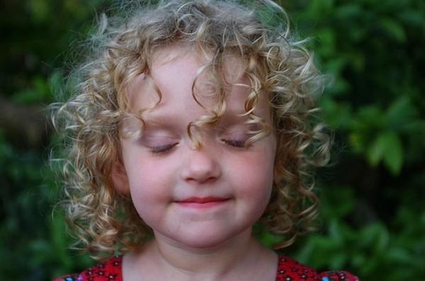
6. I have naturally curly hair.
curly hair

Slide 8
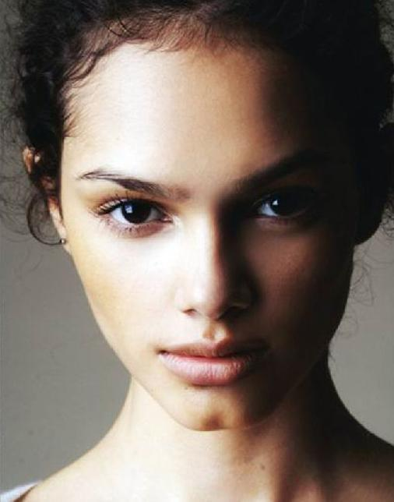
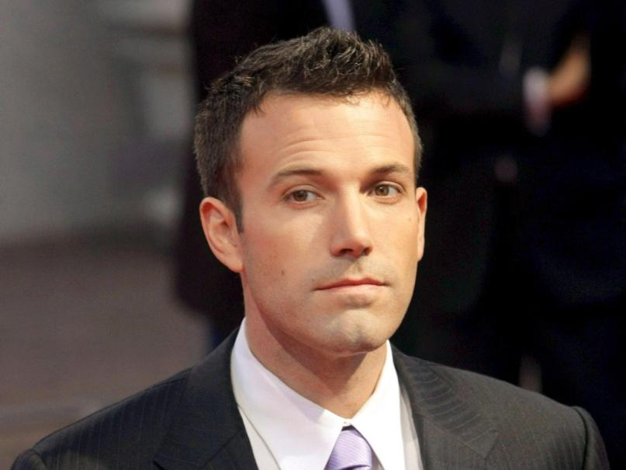
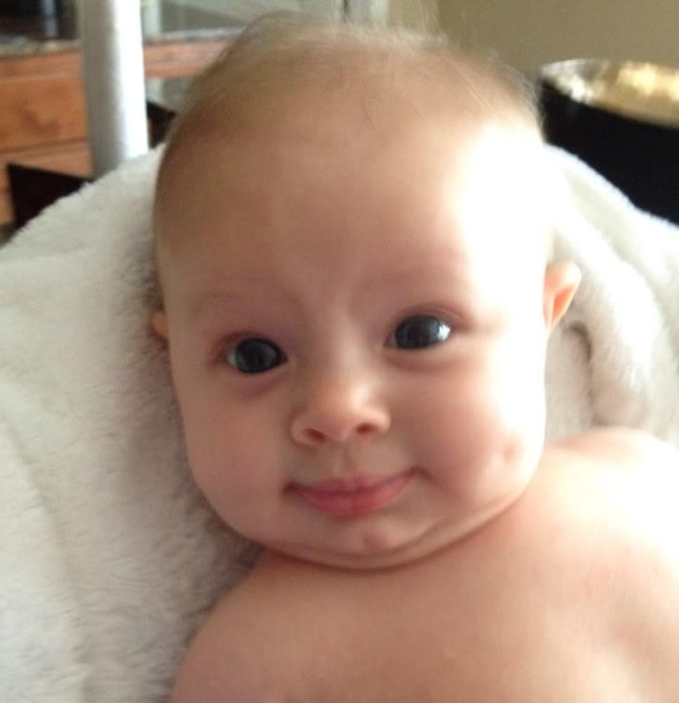
7. I have a cleft chin.
cleft chin

Slide 9
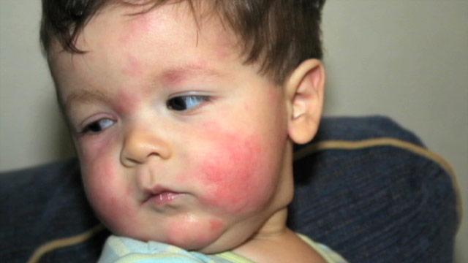
8. I have allergies.

Slide 10
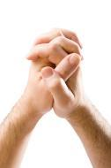
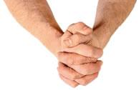
9. I cross my left thumb over my right when I clasp my hands together.

Slide 11
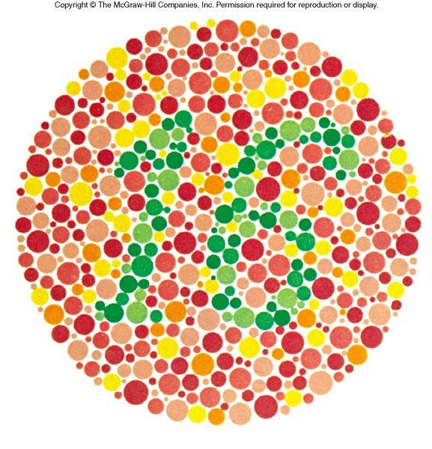
10. I can see the colors red and green. (I am not color blind)

Slide 12
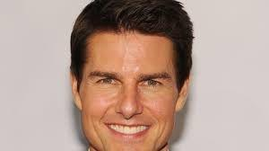
11. The hairline on my forehead is straight.

Slide 13
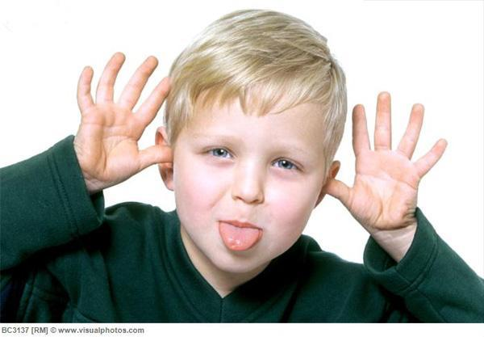
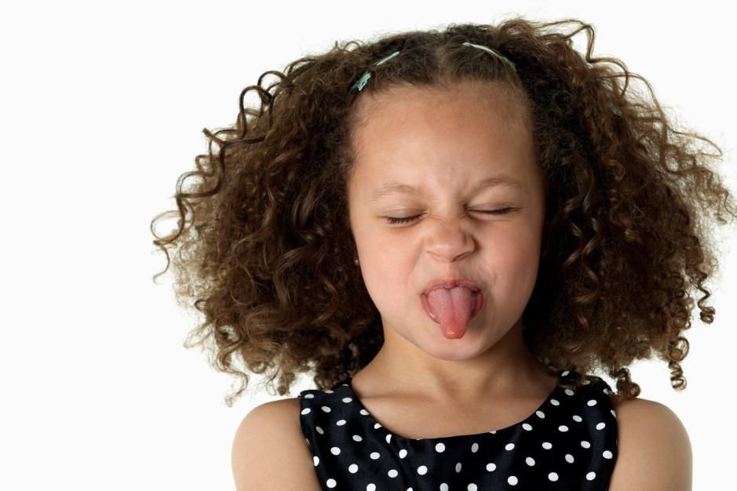
12. I am a: (male) (female)

