Slide 1
Inherited Traits and Learned Behaviors
How would you describe yourself?
Make a list of 5 characteristics…

Slide 2
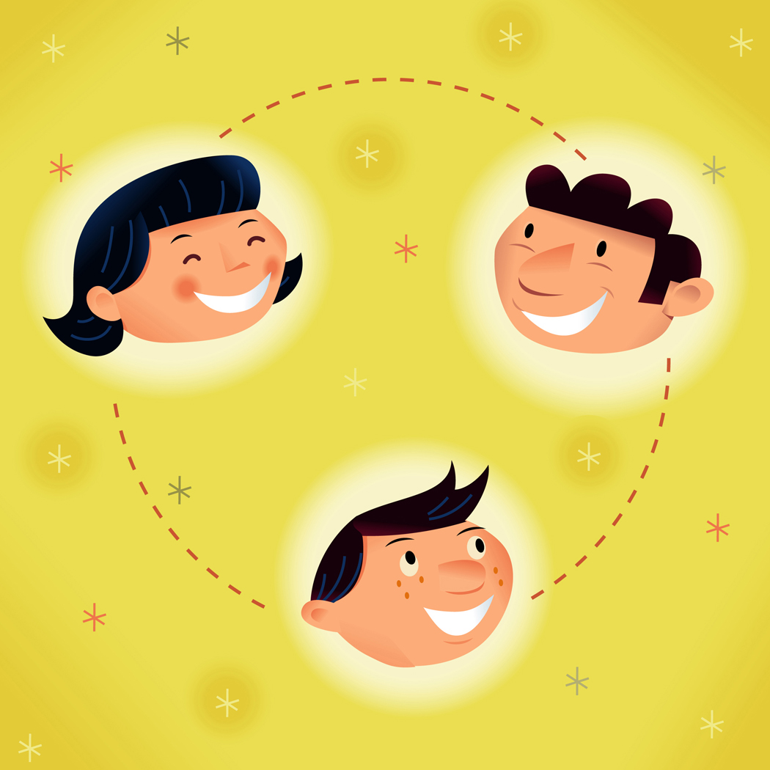
Essential Questions
How are inherited traits different from learned behaviors?
Vocabulary to Know:
Inherited trait
Offspring
Learned behavior

Slide 3
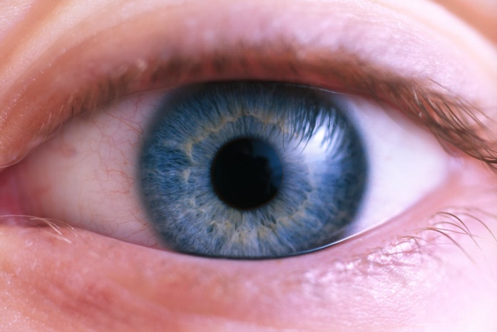
How would you describe yourself?
You might say that you have brown eyes, and that you like to skateboard.
Let’s make a list of words that describe yourself!
Now let’s look at our list…how many of your descriptions could also describe someone in your family?

Slide 4
Now let’s say that you have brown eyes and you like to skateboard…
Consider this…does anyone else in your family have brown eyes or like to skateboard?
Probably only a few of them like to skateboard…but one of your parents have brown eyes. Your eye color came from your parents, however you learned to skateboard.

Slide 5
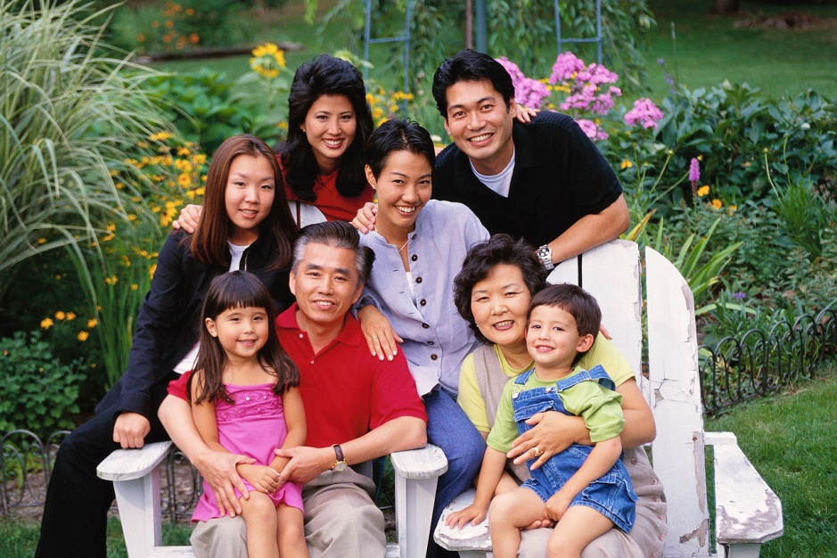
Humans and other animals are a mix of characteristics from their parents and behaviors they learned on their own
A physical characteristic that is passed from a parent to their baby (offspring) is an inherited trait.

Slide 6
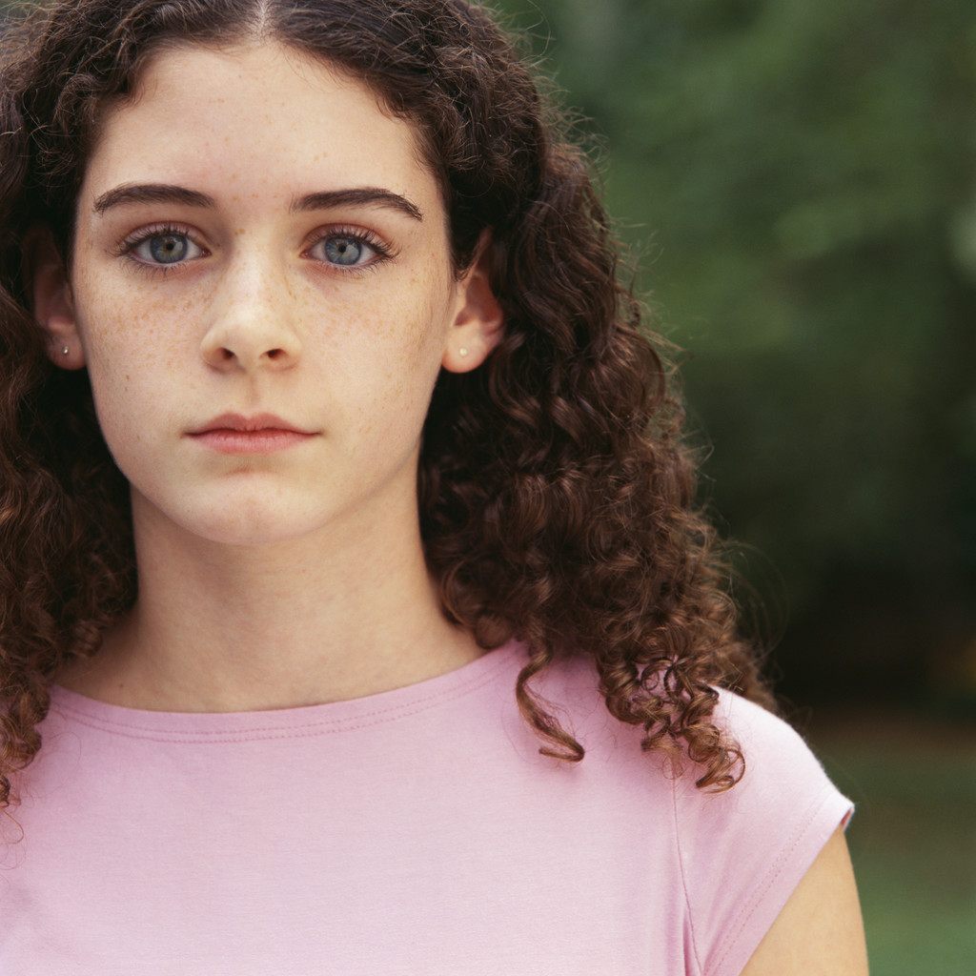
Inherited Traits
Eye color
Skin color
Hair color
Curly or straight hair
Dimples
Freckles
Height

Slide 7
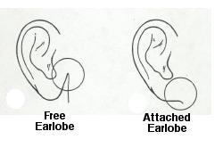
Are your ear lobes attached to the side of your head, or do they hang free?
The shape of your ear lobe is an inherited trait.

Slide 8
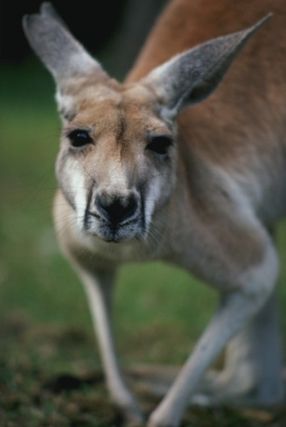
Inherited Behaviors
A behavior is a way of acting. Behaviors can be inherited too.
Inherited behaviors are called instincts.
Many animals are born with instincts that help them survive.
Can you think of any animal instincts?

Slide 9
Inherited Behavior examples…
When the weather turns chilly in the fall, animals prepare for the winter by instinct.
Some animals head for warmer climates during the winter. Other animals find a safe spot and curl up for a long sleep.
No one taught these animals how to survive winters. They know
what to do by instinct.

Slide 10
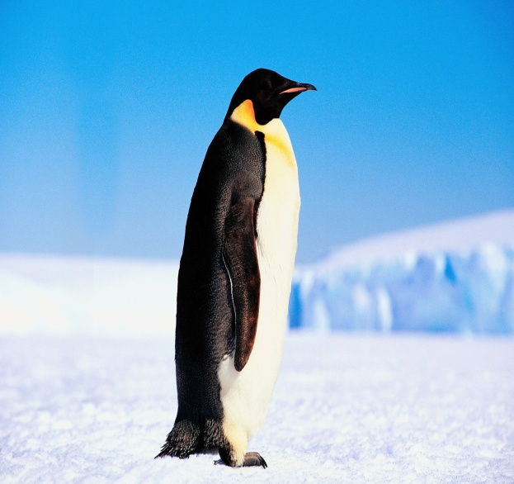
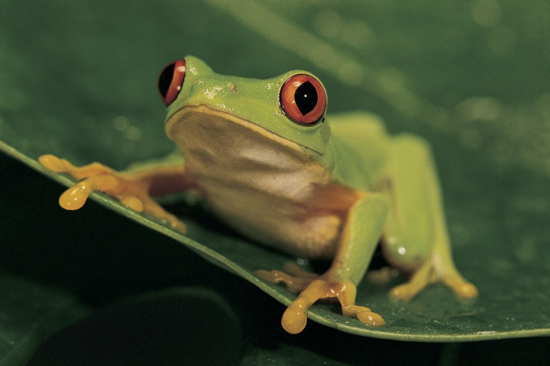
Birds protect their eggs and babies by instinct.
Frogs are not born with this instinct. They leave their eggs to hatch-or die- on their own.
Can you think of any additional inherited behaviors (instincts).

Slide 11
Learned Behaviors
Are you better at using the computer than the some of the adults in your family? If so, you learned how to do this. You did not inherit this behavior from your parents.
We learn many behaviors that helps us every day. These behaviors include how to make a sandwich, wakeboard,
and be polite to others.

Slide 12
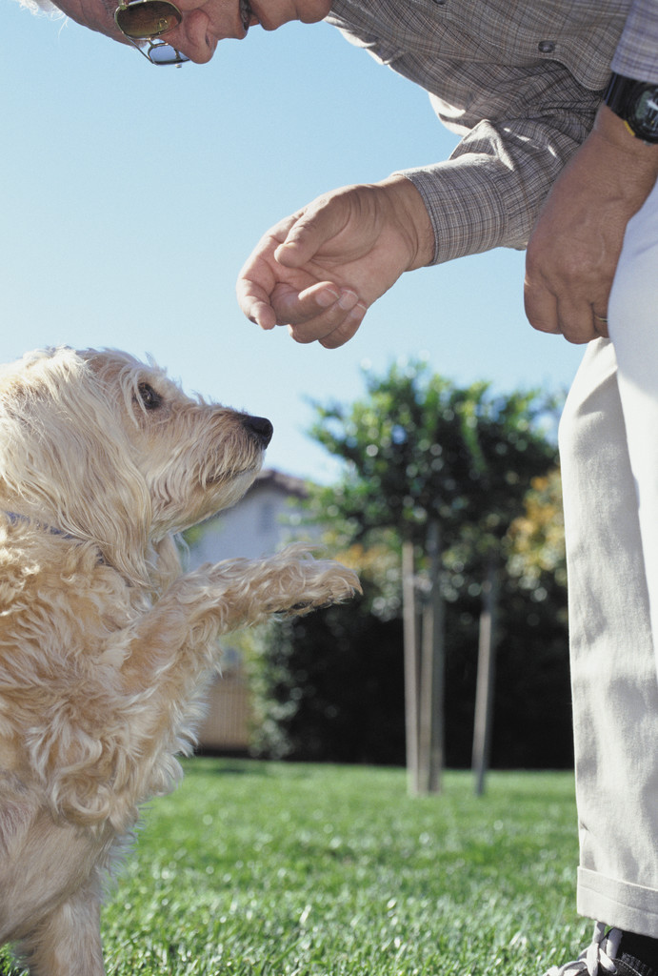
Can you learn behaviors that do not help you?
Yes!
They can include watching television or eating poorly.
Can animals learn behaviors?
Yes! Can your dog sit?

Slide 13
Let’s review…
An inherited trait is a physical characteristic that is passed from parents to their babies (offspring).
A behavior is a way of acting.
Inherited behaviors are called instincts.
Learned behaviors are not inherited but learned from others.

Slide 14

Quiz Time

Slide 15
Which of these is an inherited trait?
Liking the color red
Having long fingers
Wearing your hair in a ponytail
Liking chocolate ice cream

Slide 16
Which of these is a learned behavior?
Having long eyelashes
Having curly hair
Heading south in the fall
Liking peanut butter sandwiches

Slide 17
Which of these can you change?
Your instincts
Your inherited traits
Your learned behaviors
Your inherited behaviors

Slide 18
A woman is an excellent cook. Why are her children likely to become good cooks?
They will learn to cook by instinct
They will learn to cook by watching
They will inherit her cooking skills
Cooking is an inherited trait

